Slide 1

Conjugate Realms:
Extensions of Complementarity
Frankfurt am Oder, Berlin
July 6, 2010
V. V. Raman
vvrsps@rit.edu
http://www.rit.edu/
~vvrsps/

Slide 2


Niels Bohr’s Complementarity
Bohr: “For a parallel to the lesson of atomic theory…we must turn to quite other branches of science, such as psychology, or even to that kind of epistemological problems with which already thinkers like Buddha and Lao Tsu confronted…”

Slide 3



Extended
Complementarity Principle
There are divergent
modes of interpreting
some aspects of
perceived reality.
These may be mutually:
Contradictory,
enriching, OR antagonistic.

Slide 4

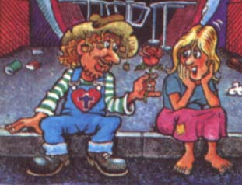
Facts and Truths
Facts are experienced consensual convictions from sensorial inputs.
Truths are interpretations of facts.

Slide 5

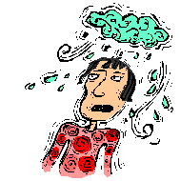
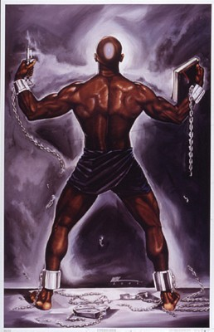

Two Kinds of Truths
Endopotent truths: interpretations that give inner experience (fulfillment, joy, meaning, etc.)
Exopotent truths:
interpretations that enable us to manipulate the external world.

Slide 6
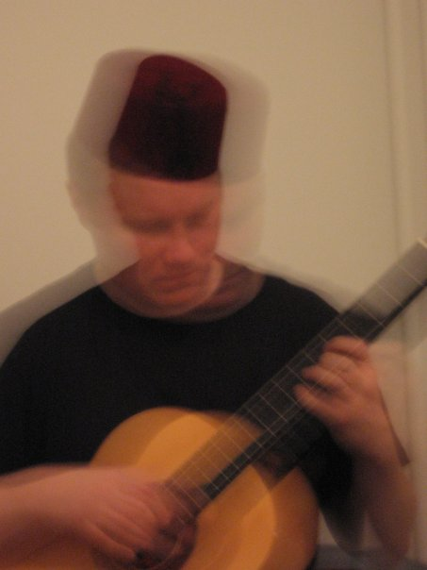


Conjugate Realms
Conjugate realms refer to perspectives on truths that are mutually complementary in the generalized sense:
Let C₁ and C₂ be truths from two conjugate realms,
M = more, L = less.
Then, we will have:
M C₁ → L C₂; L C₁ → M C₂

Slide 7
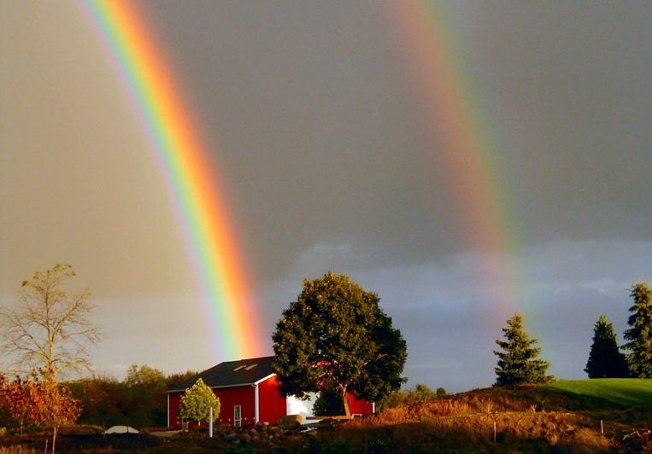

Conjugate Realms of Exotruths
Exotruths
Classical Quantum
The physical world may be studies at our scale (the meso and the macro) or at the micocosmic level.

Slide 8
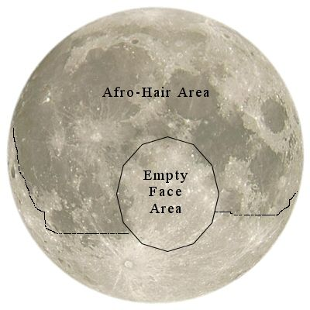
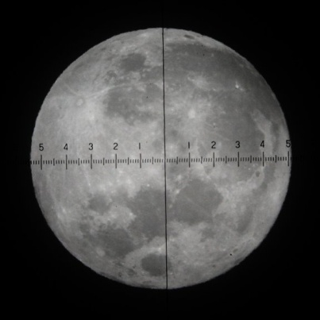
Conjugate Realms at the Classical Level
Classical World
Descriptive Quantitative
The Moon is described in various ways by an artist or a poet, and measured in other ways by an astronomer.

Slide 9
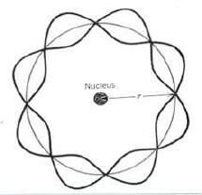
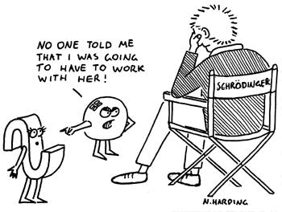
Conjugate Realms at the Quantum Level
Quantum world
Particles Waves
This was the origin of the Complementarity Principle.

Slide 10



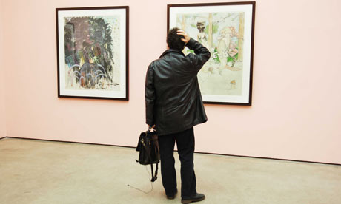
Conjugate Realms in of Endotruths
Endotruths
Holistic Individualistic
Experiential Analytical

Slide 11
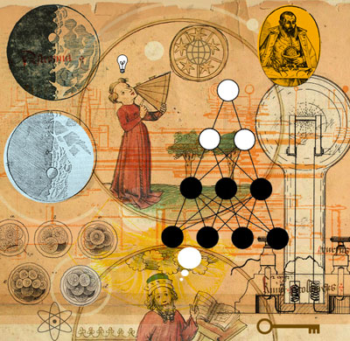


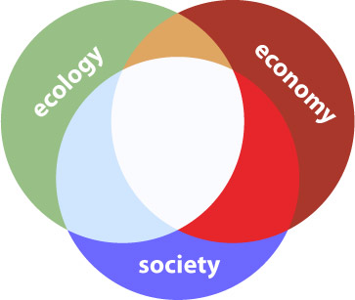
CRs in Endotruths: Examples
R R₁ R₂
History One’s own Another’s
Religion Revelation Explanation
Myths Internal External
Arts appreciative Critical
Environment Ecology Economy

Slide 12
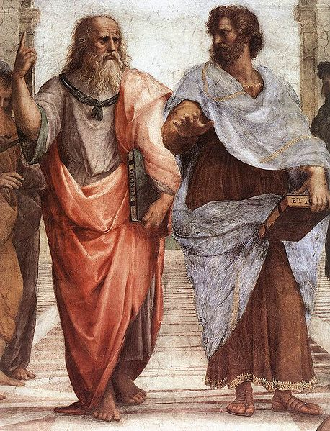
Positive Conjugates
We shall call two conjugates positive when each furnishes a new and different insight and understanding which deepens our appreciation of the system: One may point to the heavens above, other to the earth below.

Slide 13

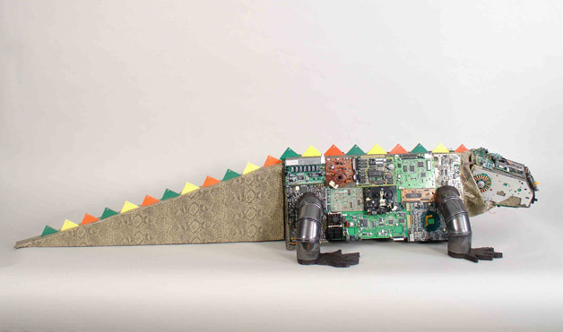
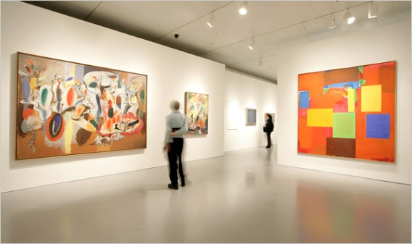
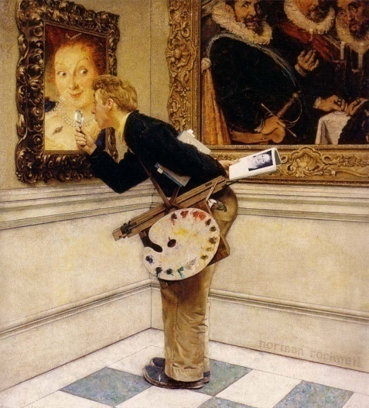


Examples of Positive CR
1. Mechanistic and vitalistic views on life.
2. Art criticism and
art appreciation.
3. Emotional &
Logical response

Slide 14
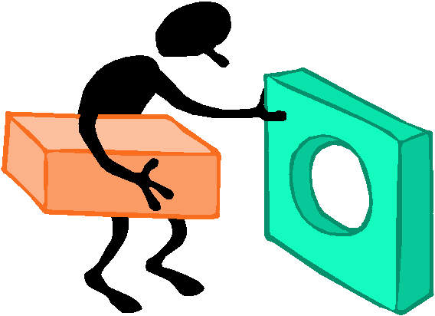


Negative Conjugates
We shall call two conjugates negative when each furnishes an opposing and inimical perspective on an issue, and deepen mutual distrust and animosity.

Slide 15

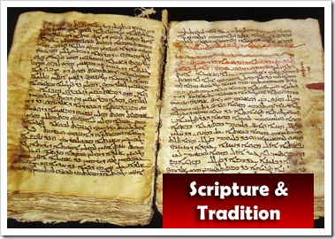


Examples of Negative CR
1. Analytical approach to Scripture and religious approach.
2. Capitalism and socialism.
3. Conservatives and liberals in politics

Slide 16



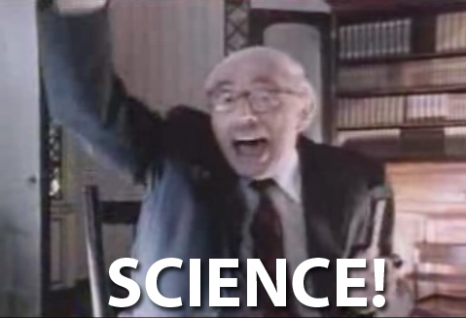

Degenerate Negative Conjugates: Extremism
Negative conjugates may sometimes degenerate into extremism which can be dangerous.
Scientism & Fundmntlsm
Reactionary & Radical
Atheism and Bigotry
Greedy captlsm & ruthless Commnsm

Slide 17



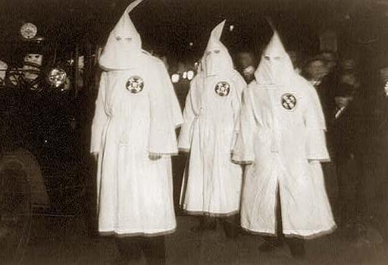
Benefits of This Analysis
1. We understand why there are different perspectives.
2. With + CRs we can learn more.
3. With – CRs we can understand how extremism arises.

Slide 18
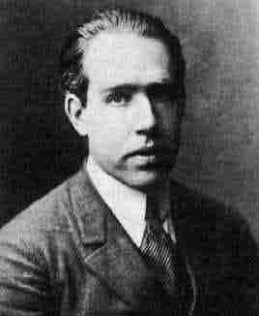
Every View is Partial or Incomplete (even of Niels Bohr)
“We must, in general, be prepared to accept the fact that the complete elucidation of one and the same object may require diverse points of view which defy a unique description.” (Niels Bohr, 1929)

Slide 19
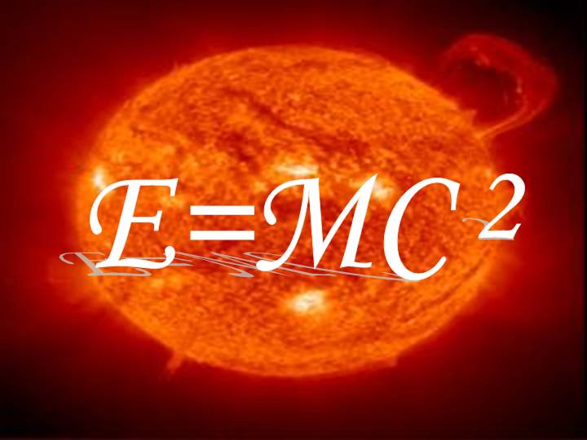

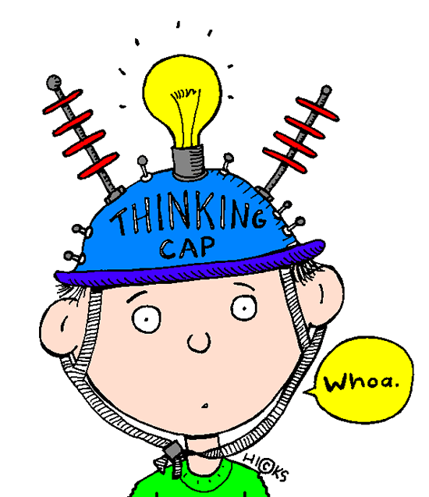
Why are there two realms?
1. The physical world arises from the duality of Matter and Energy. There can be no universe with matter alone or energy alone.
2. There is an inherent duality in the experienced human world: Reason and Emotion. There can be no human life based on reason alone or emotion alone.

Slide 20
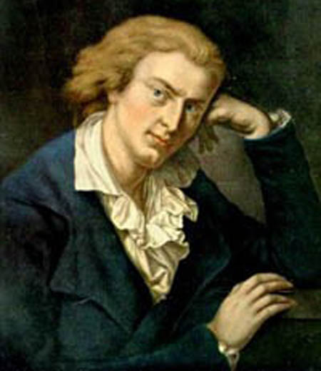
Concluding Thought
Schiller: "Nur die Fülle führt zur Klarheit.
Und im Abgrund wohnt die Wahrheit."
Die Warheit ist lehrreich, aber auch relative.
Sie ist beruhig,
aber nur eine Perspektive.

Slide 22
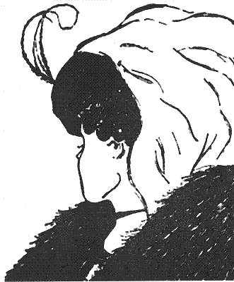

Slide 24
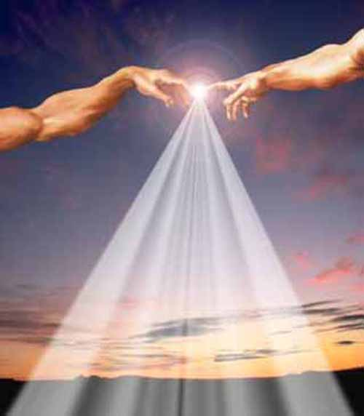
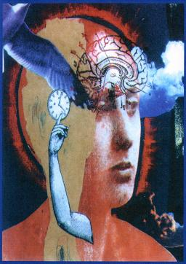
Microcosm and Macrocosm
We are the center of a circle whose radius is infinite, for the whole world is within us.
Imago Mundi

Slide 25
Philosophical Reflections
Schiller: "Nur die Fülle führt zur Klarheit. Und im Abgrund wohnt die Wahrheit."

Slide 26

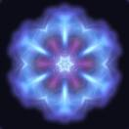
Platonic Double World
Plato: human beings and the universe both are made up of a material body and a rational soul. The human body is from the universe's body, the human soul must derive from the universe's soul.
- Philebus

Slide 27
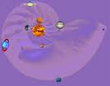
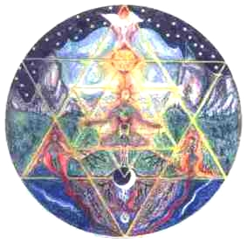
Hindu Vision
Tat tvam asi:
Thou are That.
The individual (jivatman) is a spark from the Divine (paramatman).

Slide 28

Why ARE THERE CONFLICTS?
A deeper reason for the conflict: Each group claims it alone has the Truth.

Slide 29
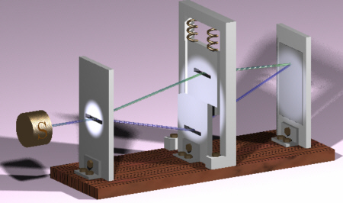
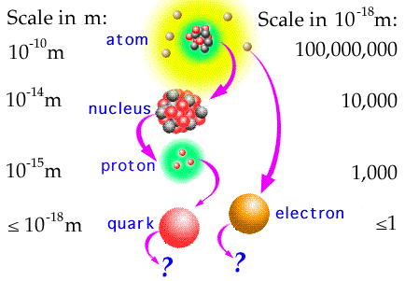
Microcosm in Modern Physics
In physics the quantum
world of atoms and
electrons and protons
may be regarded as the
microcosm, for it
is truly the small world.

Slide 30
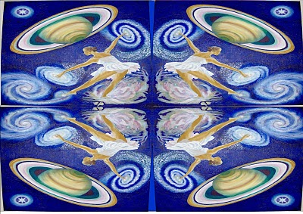
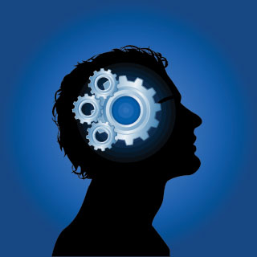
Microcosm and Macrocosm Revisted
With respect to the microcosmic quantum world, we are the macrocosm.
Some principles operating there have a correspondence with the world of our experience.

